Slide 1
GENAI DEVELOPER GCP BRIGHTSPEED
AIRFLOW

Slide 2
Apache Airflow – Method1 (Docker)
Ref: https://code.visualstudio.com/docs/python/python-tutorial#_create-a-virtual-environment

Slide 3
Airflow Overview
Prerequisites:
Understanding of Basic Python
Ref: https://code.visualstudio.com/docs/python/python-tutorial#_create-a-virtual-environment

Slide 4
Overview
Airflow™ is a platform created by the community to programmatically:
Author, schedule and monitor workflows
Principles:
Features:
Pure Python
No more command-line or XML black-magic! Use standard Python features to create your workflows, including date time formats for scheduling and loops to dynamically generate tasks
Useful UI
Monitor, schedule and manage your workflows via a robust and modern web application
Robust Integrations
Airflow™ provides many plug-and-play operators that are ready to execute your tasks on Google Cloud Platform, Amazon Web Services, Microsoft Azure and many other third-party services
This allows you to maintain full flexibility when building your workflows
No need to learn old, cron-like interfaces. You always have full insight into the status and logs of completed and ongoing tasks
This makes Airflow easy to apply to current infrastructure and extend to next-gen technologies
Elegant
Airflow™ pipelines are lean and explicit. Parametrization is built into its core using the powerful Jinja templating engine.
Scalable
Airflow™ has a modular architecture and uses a message queue to orchestrate an arbitrary number of workers
Dynamic
Airflow™ pipelines are defined in Python, allowing for dynamic pipeline generation
Extensible
Easily define your own operators and extend libraries to fit the level of abstraction that suits your environment.
Airflow™ is ready to scale to infinity.
This allows for writing code that instantiates pipelines dynamically.
Easy to Use
Anyone with Python knowledge can deploy a workflow
Open Source
Wherever you want to share your improvement you can do this by opening a PR
Apache Airflow™ does not limit the scope of your pipelines; you can use it to build ML models, transfer data, manage your infrastructure, and more
It’s simple as that, no barriers, no prolonged procedures
Airflow has many active users who willingly share their experiences

Slide 5
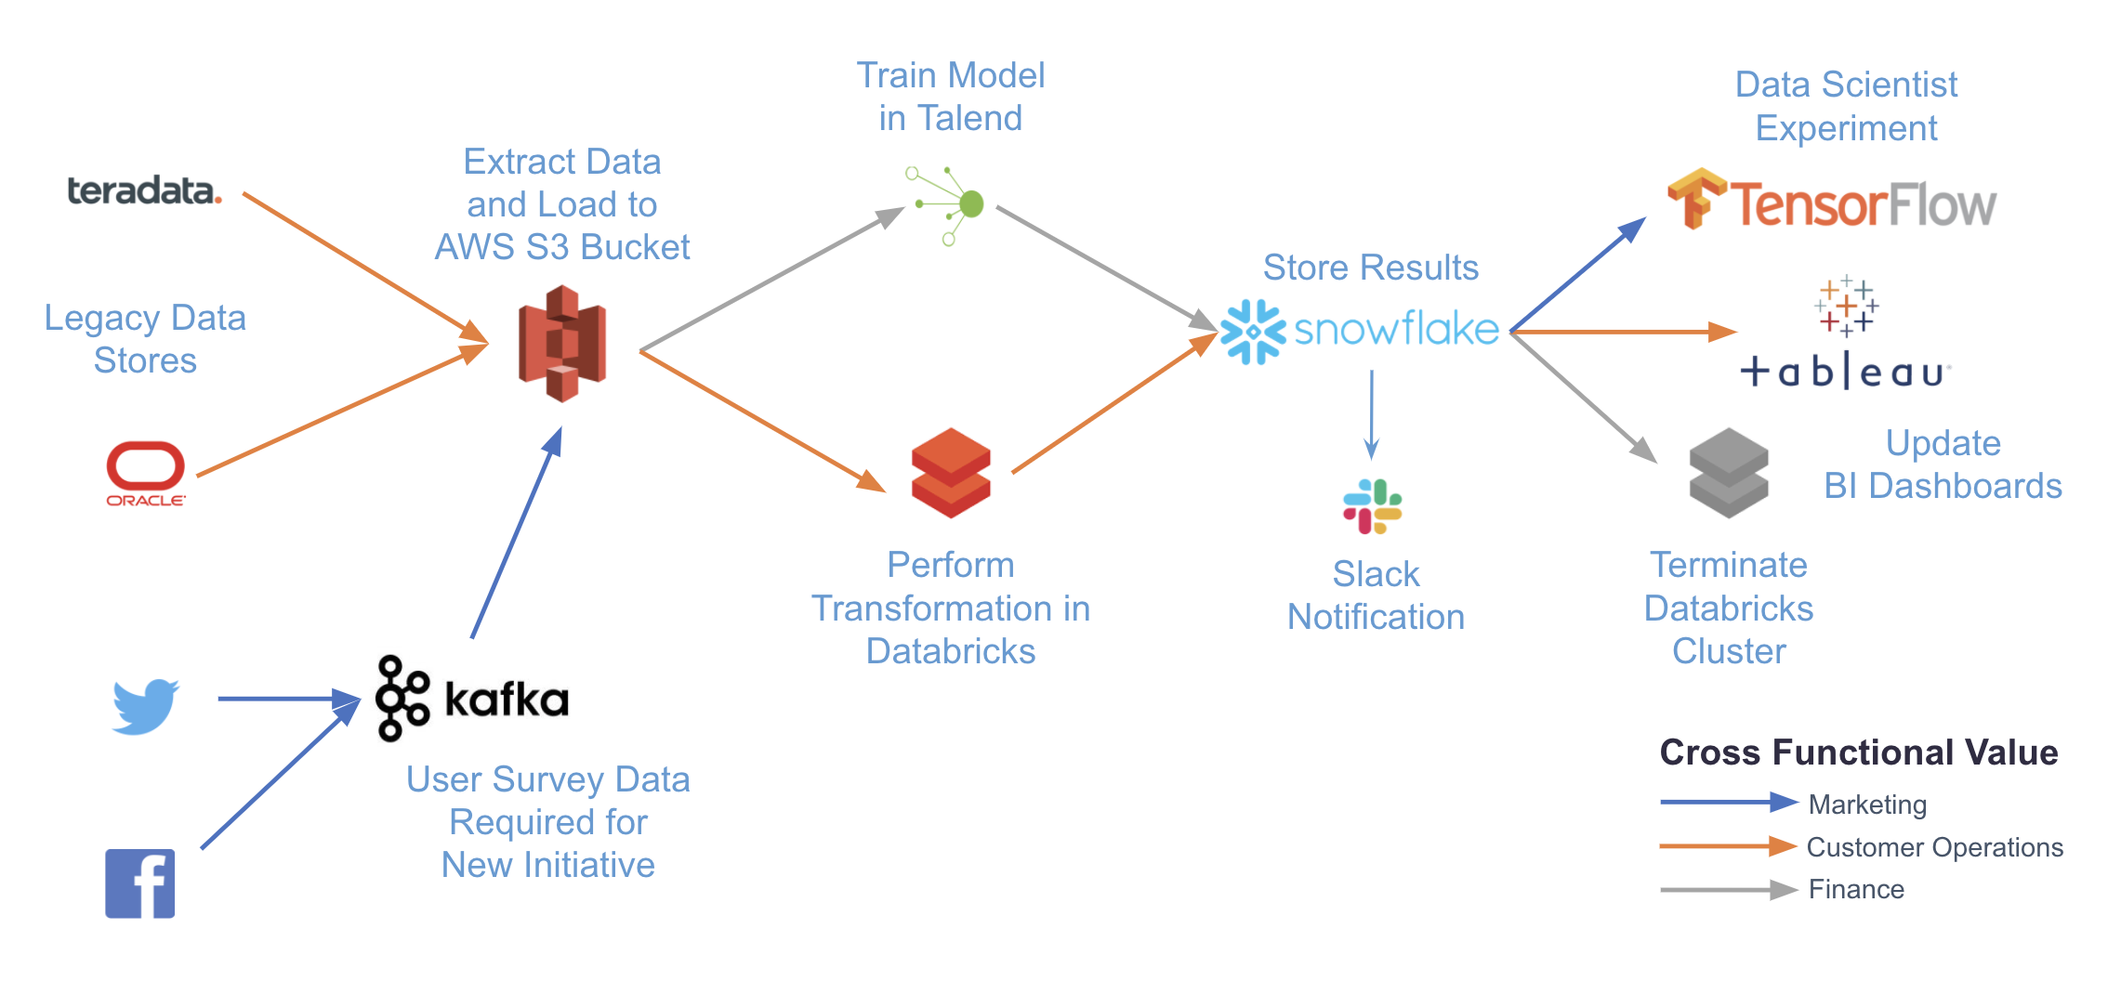
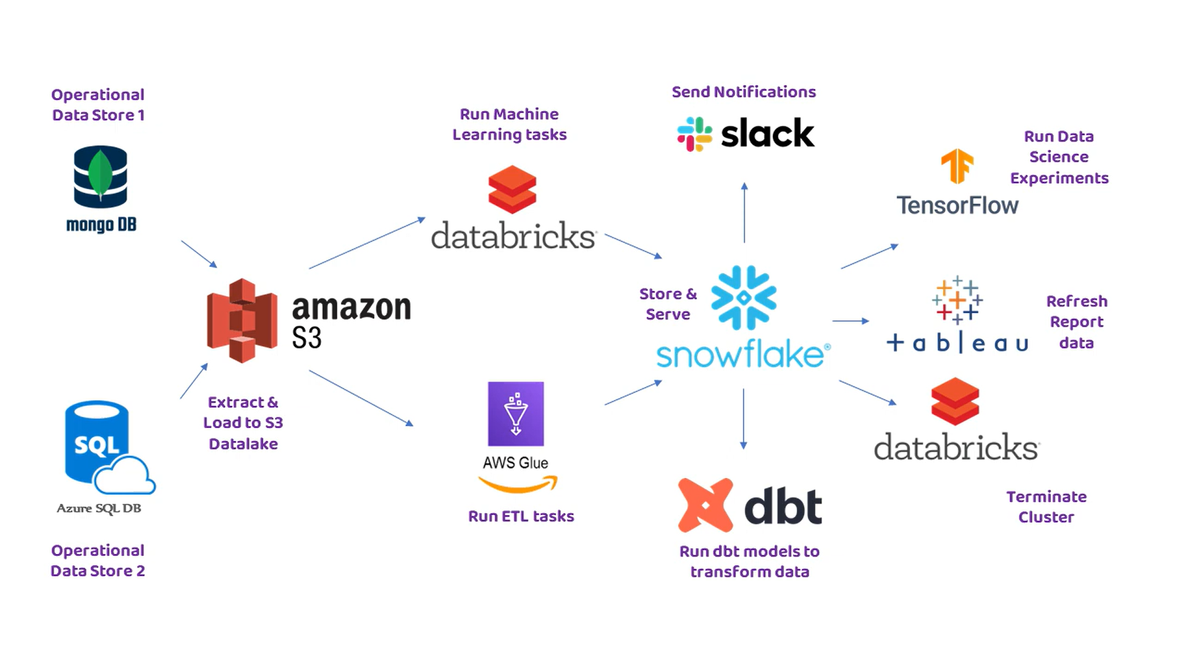
Overview
Maxime Beauchemin created Airflow in 2015 to allow Airbnb to quickly:
Author, iterate, and monitor batch data pipelines
When to use Airflow
Airflow can be used for almost any batch data pipeline
Airflow is particularly powerful for orchestrating jobs with complex dependencies in multiple external systems
The following diagram illustrates a complex use case that can be accomplished with Airflow:
By writing pipelines in code and using Airflow providers, you can integrate with any number of different systems with just a single platform for orchestration and monitoring
Ref: https://docs.astronomer.io/learn/intro-to-airflow

Slide 6
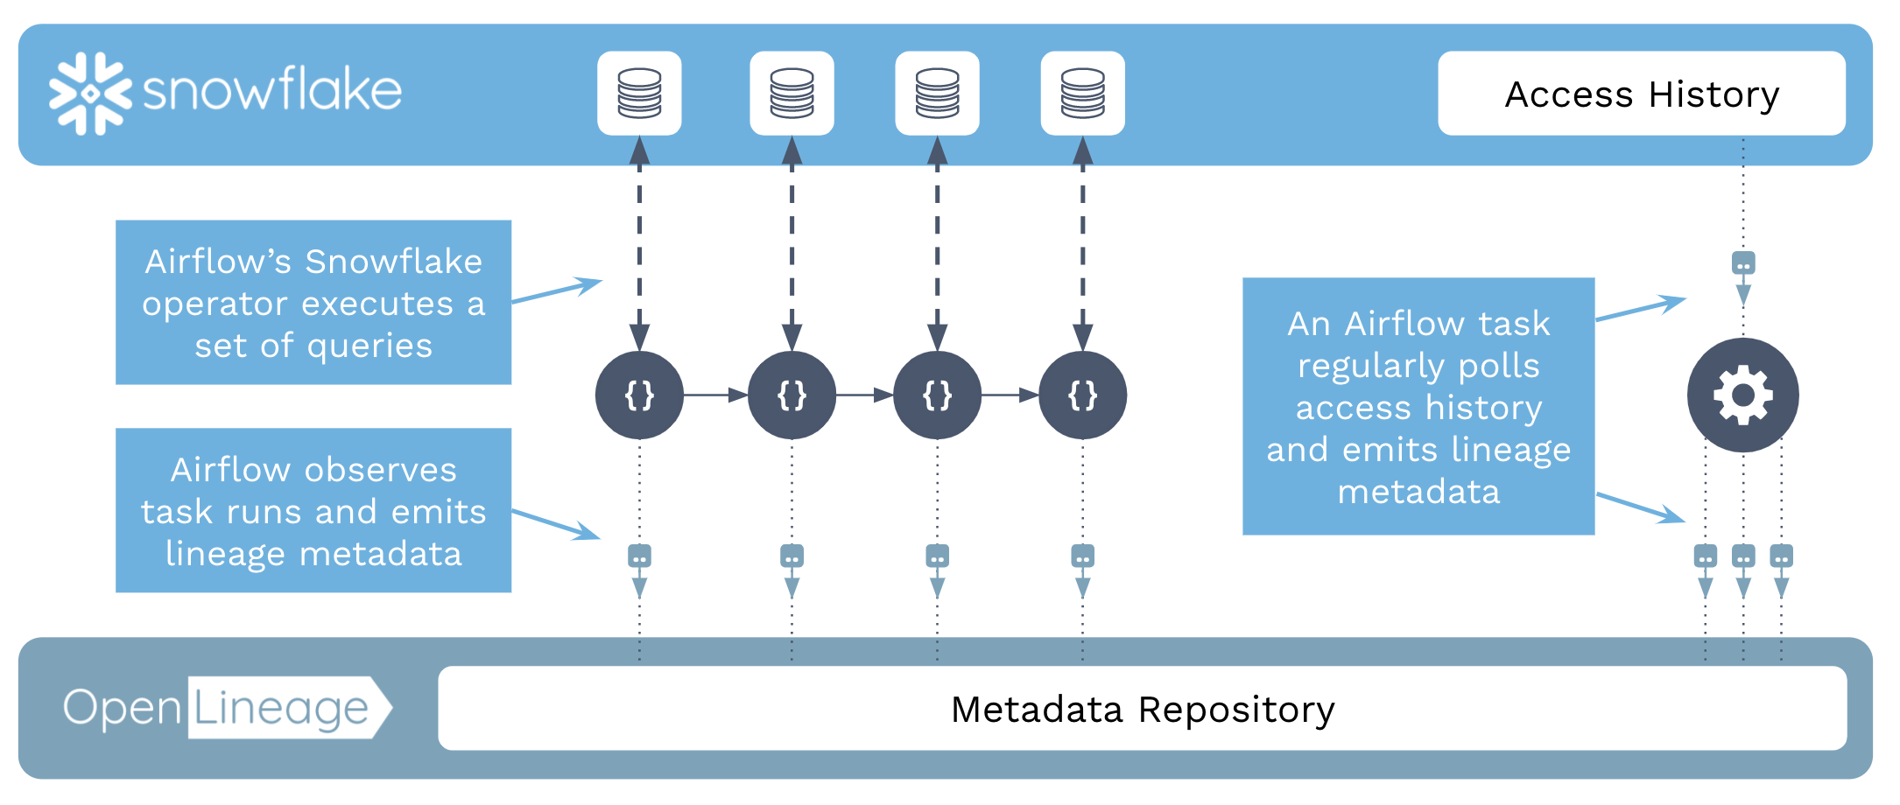
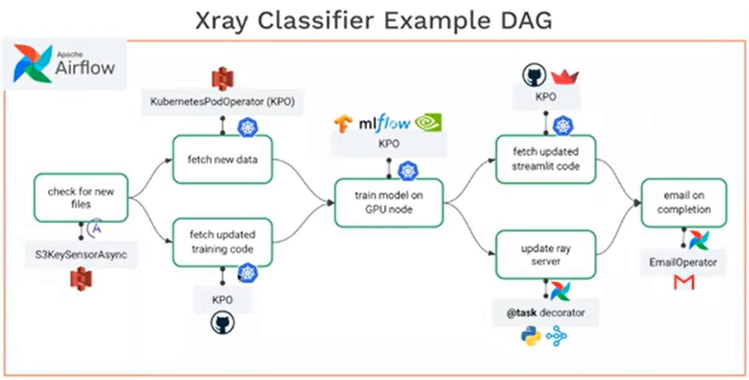
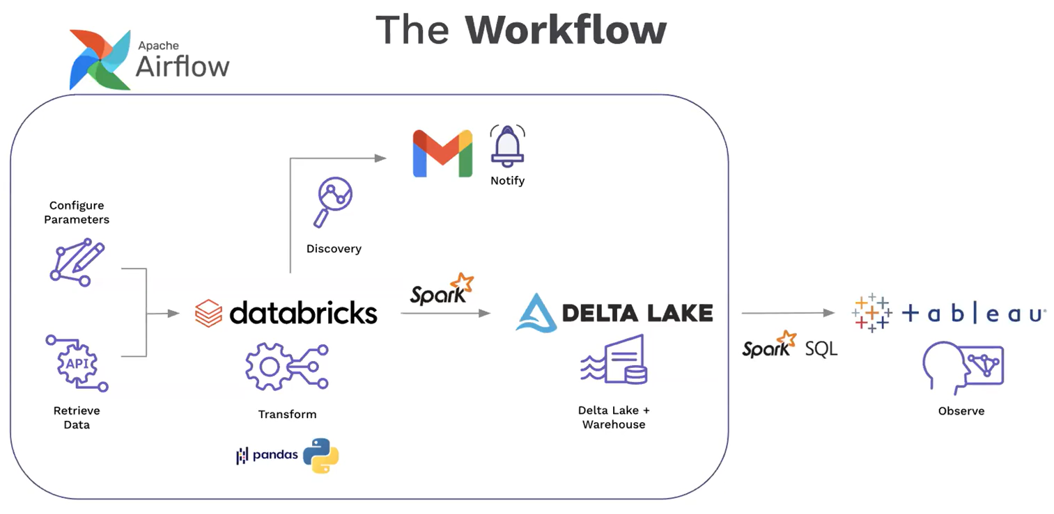
Overview
Some common use cases of Airflow include:
ETL/ELT pipelines: For example, running a write, audit, publish pattern on data in Snowflake as shown in Orchestrating Snowflake Queries with Airflow.
MLOps: For example, using Airflow with Tensorflow and MLFlow as shown in Using Airflow with Tensorflow and MLFlow.
Operationalized analytics: For example, orchestrating a pipeline to extract insights from your data and display them in dashboards as shown in Using Airflow as a Data Analyst.
Ref: https://docs.astronomer.io/learn/intro-to-airflow

Slide 7
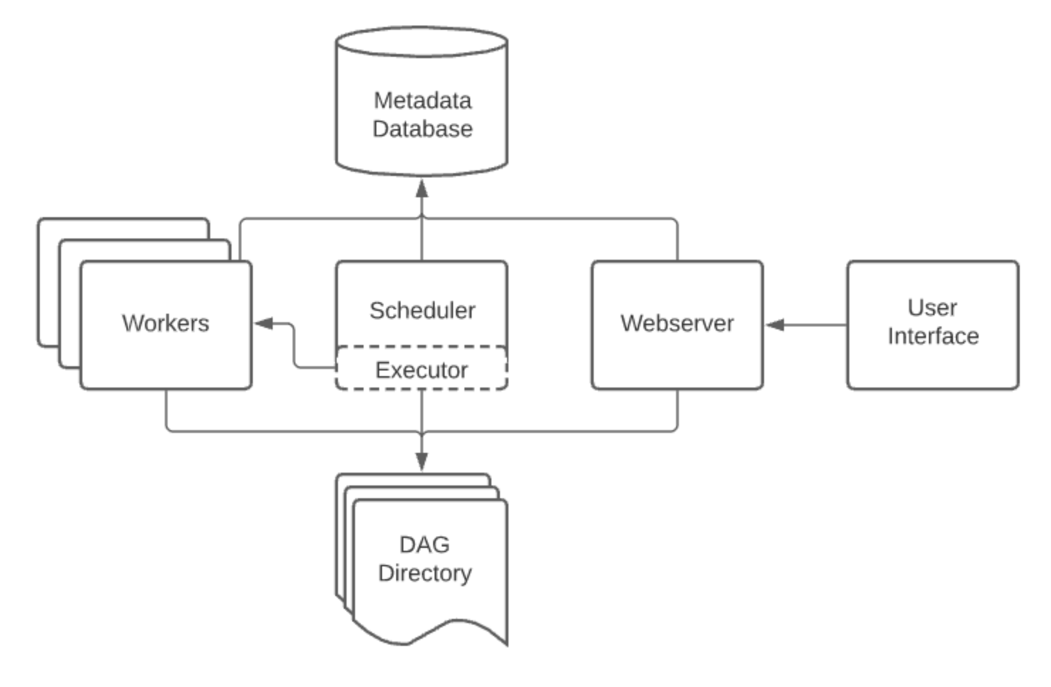
Overview
Core Airflow concepts
DAG: Directed Acyclic Graph. An Airflow DAG is a workflow defined as a graph, where all dependencies between nodes are directed and nodes do not self-reference.
DAG run: The execution of a DAG at a specific point in time. A DAG run can be scheduled or manually triggered.
Task: A step in a DAG describing a single unit of work.
Task instance: The execution of a task at a specific point in time.
Operators: When authoring DAGs, you use operators. An operator is an abstraction over Python code designed to perform a specific action and takes the form of a function that accepts parameters.
Each operator in your DAG code corresponds to one Airflow task.
The following are the primary operator categories:
Action operators: Execute a function
Example, the PythonOperator or the BashOperator.
Transfer operators: Move data from a source to a destination
Example, the S3ToRedshiftOperator.
Sensors: Wait for something to happen
Example, the ExternalTaskSensor or the HttpSensorAsync.
While operators are defined individually, they can pass information to each other by using Xcoms
Airflow components
The following Airflow components must be running at all times:
Webserver: A Flask server running with Gunicorn that serves the Airflow UI.
Scheduler: A Daemon responsible for scheduling jobs. This is a multi-threaded Python process that determines what tasks need to be run, when they need to be run, and where they are run.
Database: A database where all DAG and task metadata are stored. This is typically a Postgres database, but MySQL and SQLite are also supported.
Executor: The mechanism that defines how the available computing resources are used to execute tasks. An executor is running within the scheduler whenever Airflow is up.
Additionally, you may also have the following situational components:
Triggerer: A separate process which supports deferrable operators. This component is optional and must be run separately.
Worker: The process that executes tasks, as defined by the executor. Depending on which executor you choose, you may or may not have workers as part of your Airflow infrastructure.
Ref: https://docs.astronomer.io/learn/intro-to-airflow

Slide 8
Operators
Operator basics
Operators are Python classes that encapsulate logic to do a unit of work. They can be viewed as a wrapper around each unit of work that defines the actions that will be completed and abstract the majority of code you would typically need to write
When you create an instance of an operator in a DAG and provide it with its required parameters, it becomes a task.
All operators inherit from the abstract BaseOperator class, which contains the logic to execute the work of the operator within the context of a DAG.
The following are some of the most frequently used Airflow operators:
PythonOperator: Executes a Python function.
BashOperator: Executes a bash script.
KubernetesPodOperator: Executes a task defined as a Docker image in a Kubernetes Pod.
SnowflakeOperator: Executes a query against a Snowflake database.
The core Airflow package includes basic operators such as the PythonOperator and BashOperator. These operators are automatically available in your Airflow environment
Note: All other operators are part of provider packages, which you must install separately. For example, the SnowflakeOperator is part of the Snowflake provider package
Operators are the building blocks of Airflow DAGs
They contain the logic of how data is processed in a pipeline
Each task in a DAG is defined by instantiating an operator
There are many different types of operators available in Airflow
Some operators such as Python functions execute general code provided by the user
While other operators perform very specific actions such as transferring data from one system to another
Ref: https://docs.astronomer.io/learn/what-is-an-operator=

Slide 9
Directed Acyclic Graphs
In Airflow:
Data pipelines: are defined in Python code as directed acyclic graphs (DAGs)
Within a graph:
each node: represents a task which completes a unit of work
each edge: represents a dependency between tasks
The mathematical properties of DAGs make them useful for building data pipelines:
Directed: If multiple tasks exist, then each task must have at least one defined upstream or downstream task.
Acyclic: Tasks cannot have a dependency to themselves. This avoids infinite loops.
Graph: All tasks can be visualized in a graph structure, with relationships between tasks defined by nodes and vertices.
Writing a DAG
DAGs in Airflow are defined in a Python script that is placed in an Airflow project's DAG_FOLDER. Airflow will execute the code in this folder to load any DAG objects
Most DAGs follow this general flow within a Python script:
Imports: Any needed Python packages are imported at the top of the DAG script. This always includes a dag function import (either the DAG class or the dag decorator). It can also include provider packages or other general Python packages.
DAG instantiation: A DAG object is created and any DAG-level parameters such as the schedule interval are set.
Task instantiation: Each task is defined by calling an operator and providing necessary task-level parameters.
Dependencies: Any dependencies between tasks are set using bitshift operators (<< and >>), the set_upstream() or set_downstream functions, or the chain() function. Note that if you are using the TaskFlow API, dependencies are inferred based on the task function calls.
Ref: https://docs.astronomer.io/learn/dags

Slide 10
Install Airflow; Write & Run DAG; Windows Docker
Ref: https://code.visualstudio.com/docs/python/python-tutorial#_create-a-virtual-environment

Slide 11
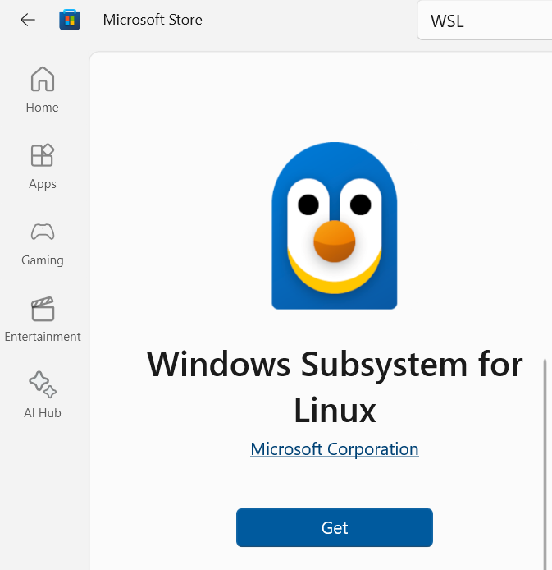
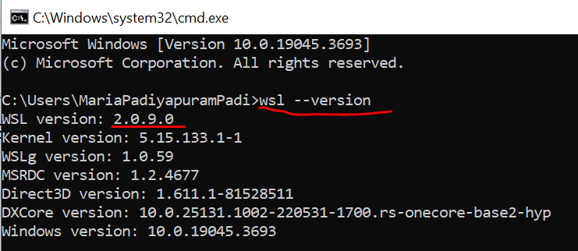
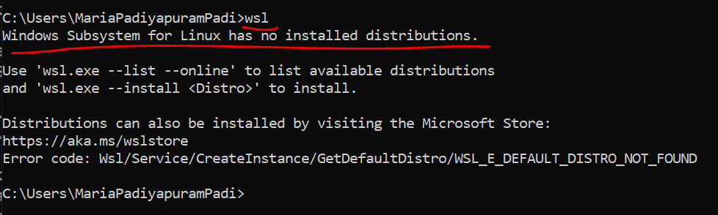
Apache Airflow
Install WSL
https://learn.microsoft.com/en-us/windows/wsl/install
Prerequisites: Windows 10 version 2004 and higher
Go to Microsoft Store and ‘Get’ Windows Subsystem for Linux
To check and make sure you have the Microsoft Store version, press the windows key +R, type cmd, then run the wsl –version command from the command prompt.
Check if Linux is installed
Type wsl in cmd prompt
Windows Subsystem for Linux has no installed distributions msg will be displayed
Ref: https://vivekjadhavr.medium.com/how-to-easily-install-apache-airflow-on-windows-6f041c9c80d2; https://learn.microsoft.com/en-us/windows/wsl/install; https://learn.microsoft.com/en-us/answers/questions/1112206/a-connection-with-the-server-could-not-be-establish; https://www.freecodecamp.org/news/install-apache-airflow-on-windows-without-docker/

Slide 12
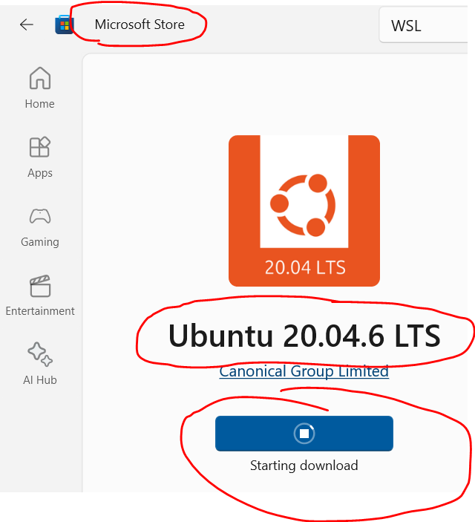
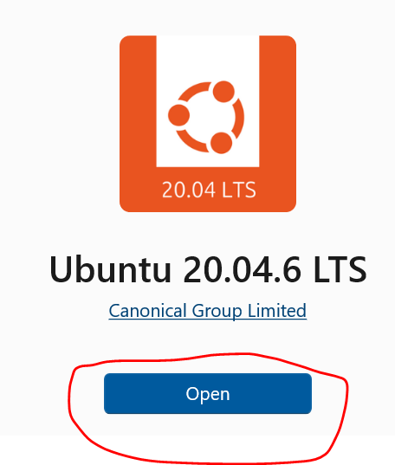
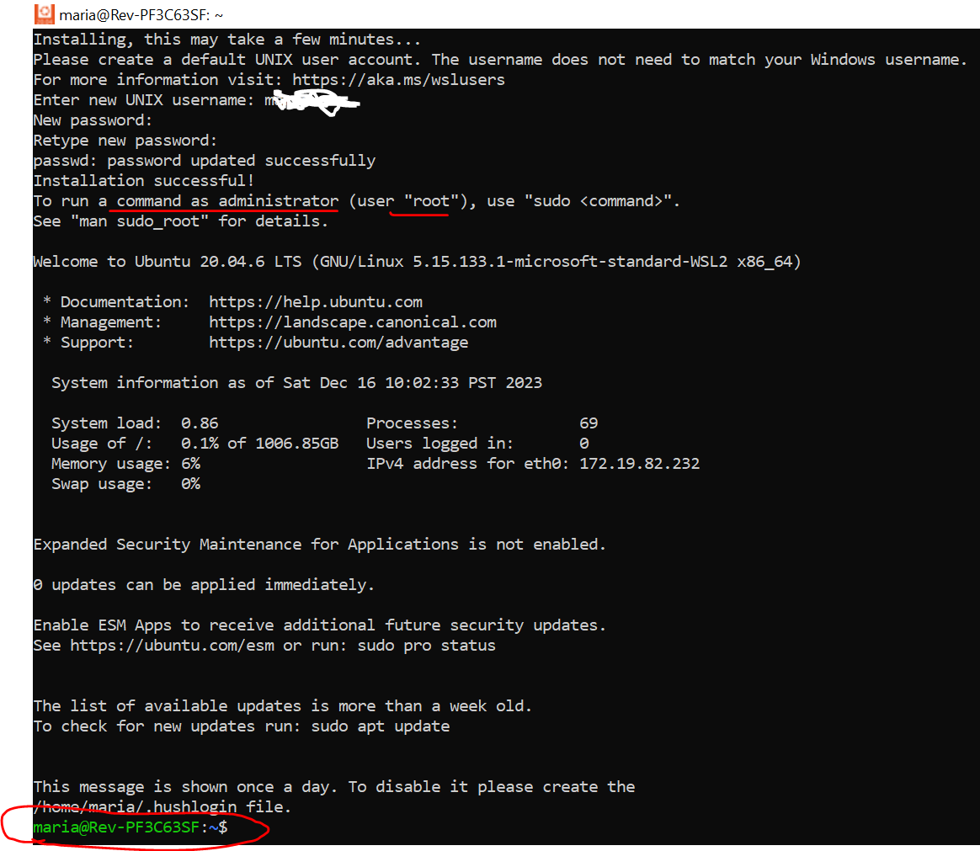
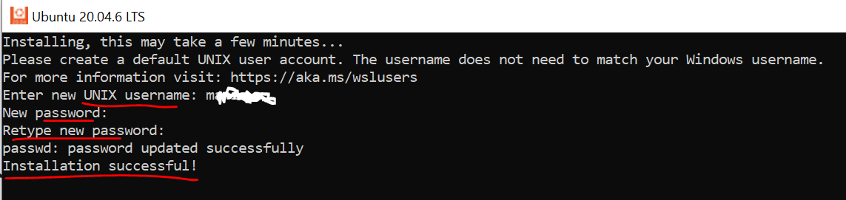
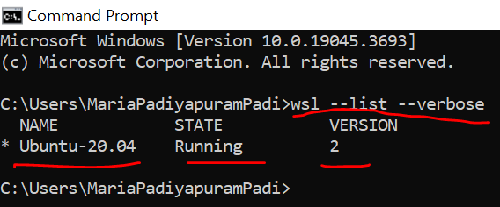
Apache Airflow
Install Ubuntu
Run CMD as Administrator
Set wsl to wsl2, by running the below:
wsl --set-default-version 2
Go to Microsoft Store and ‘Get’ Ubuntu v20x
Open Ubuntu
Enter the username and password when prompted
Open cmd prompt to check the instaled Ubuntu version
wsl --list --verbose
Ref: https://vivekjadhavr.medium.com/how-to-easily-install-apache-airflow-on-windows-6f041c9c80d2; https://learn.microsoft.com/en-us/windows/wsl/install; https://learn.microsoft.com/en-us/answers/questions/1112206/a-connection-with-the-server-could-not-be-establish; https://www.freecodecamp.org/news/install-apache-airflow-on-windows-without-docker/

Slide 13
Apache Airflow
Install: from Microsoft Store
WSL
Ubuntu
Create a workspace in C drive:
C:\workspace
Open command prompt: cmd
Cd to C:\workspace
C:\Users\MariaPadiyapuramPadi>cd ..
C:\Users>cd ..
C:\>cd workspace
C:\workspace>code .
This will open VS code in workspace folder
C:\workspace>
Ref: https://www.youtube.com/watch?v=N3Tdmt1SRTM&t=370s

Slide 14
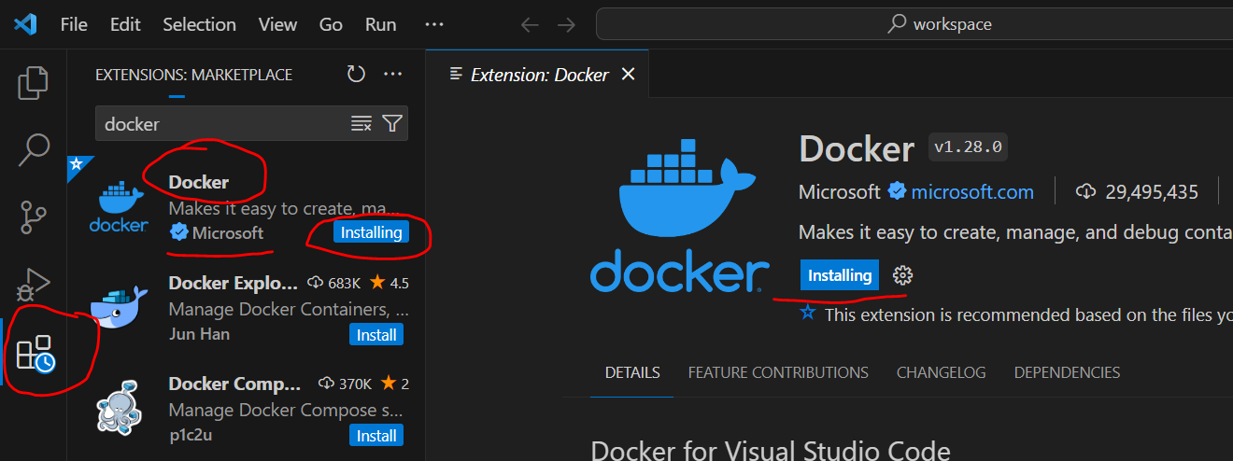
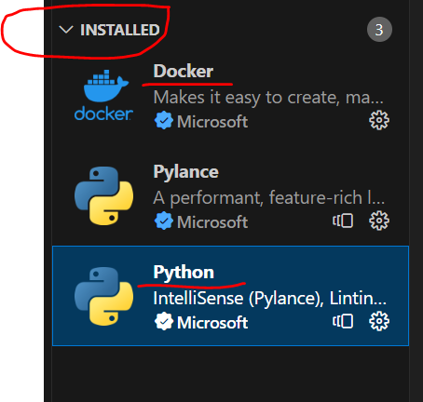
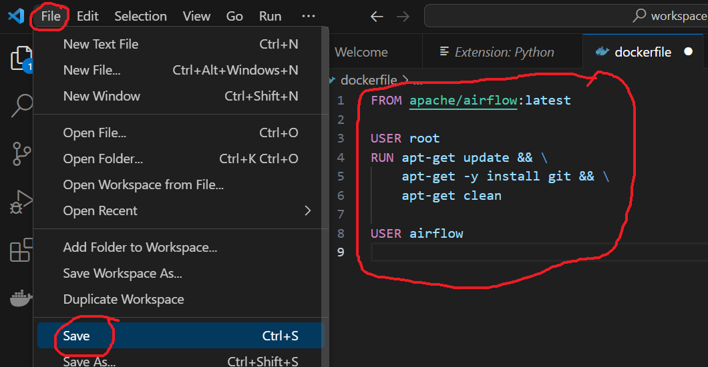
Apache Airflow
Install: docker and python extension in VS Code
Create Configuration files for Docker:
Dockerfile
Instructions to build docker image
docker-compose.yml
Volumes, networking and other configurations for one or more docker containers
Create a file named ‘dockerfile’
Paste the below code: to create a docker image
FROM apache/airflow:latest
USER root
RUN apt-get update && \
apt-get -y install git && \
apt-get clean
USER airflow
Save the file
Ref: https://www.youtube.com/watch?v=N3Tdmt1SRTM&t=370s

Slide 15
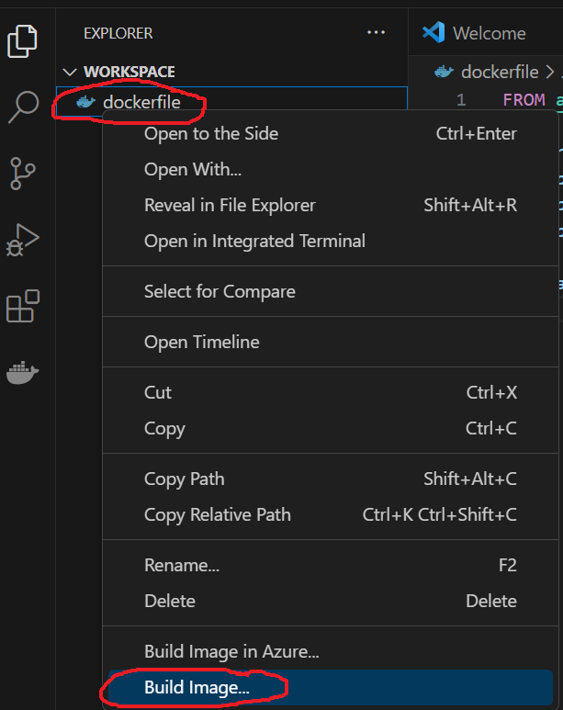
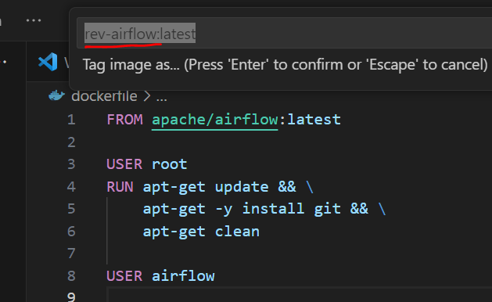
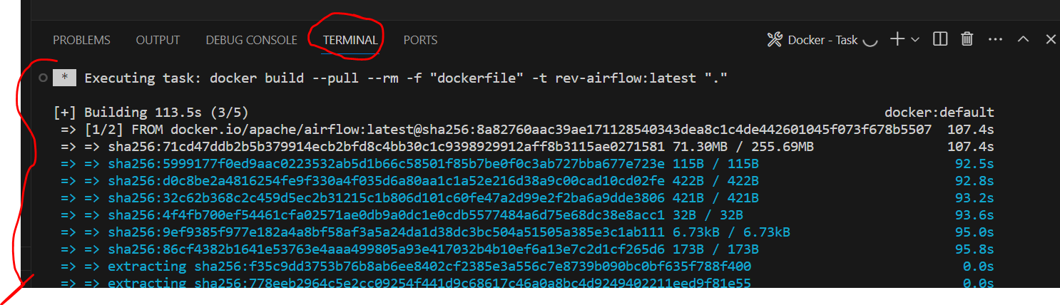
Apache Airflow
Build Image: right click dockerfile and click on Build Image
Give a custom name:
Rev-airflow:latest
Will download the official Apache docker image and build our own custom image
Ref: https://www.youtube.com/watch?v=N3Tdmt1SRTM&t=370s

Slide 16
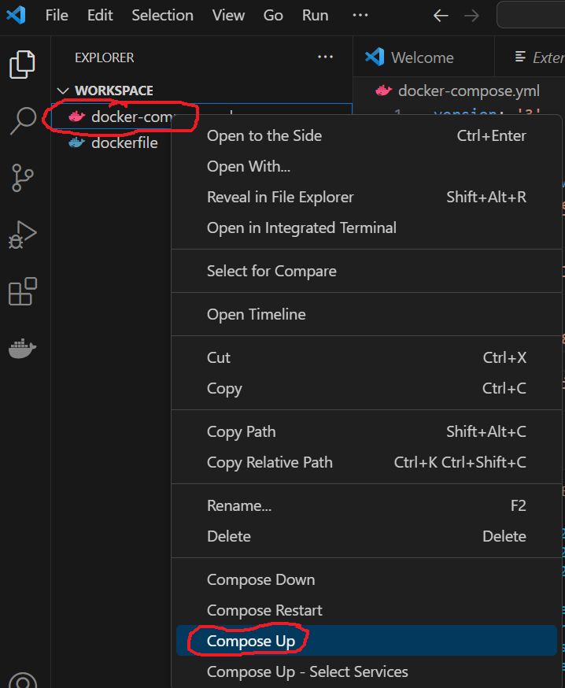
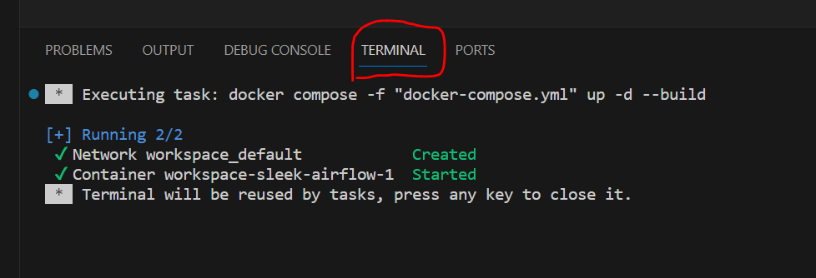
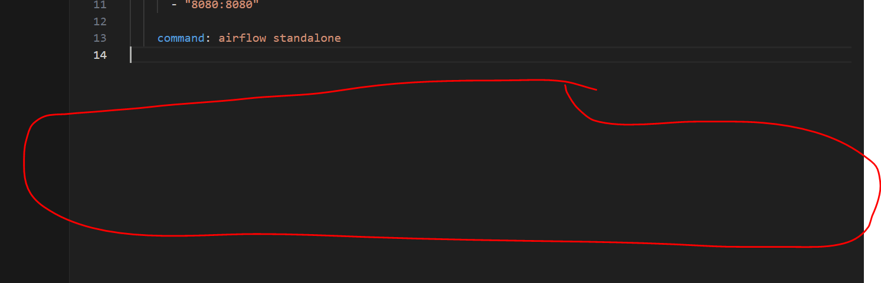
Apache Airflow
Create another file named ‘docker-compose.yml’
Paste the below code: to create a docker image
version: '3'
services:
sleek-airflow:
image: Rev-airflow:latest
volumes:
- ./airflow:/opt/airflow
ports:
- "8080:8080"
command: airflow standalone
Save the file
Add custom airflow image created in previous step
Links the airflow directory in local machine with directory in container
Volume: is for persistence and not to lose data on restart
Launch Airflow:
Right click ‘docker-compose.yml’ and click on ‘Compose Up’
Once the task is complete as seen in ‘Terminal’
Click inside Terminal and press ‘Enter’ to close the Terminal window
Note: image name should be the name used in build image while running ‘dockerfile’
Ref: https://www.youtube.com/watch?v=N3Tdmt1SRTM&t=370s

Slide 17
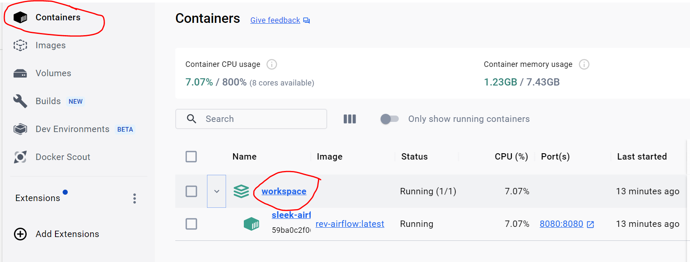
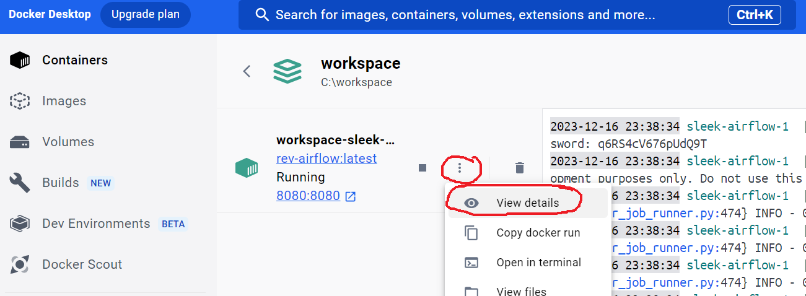
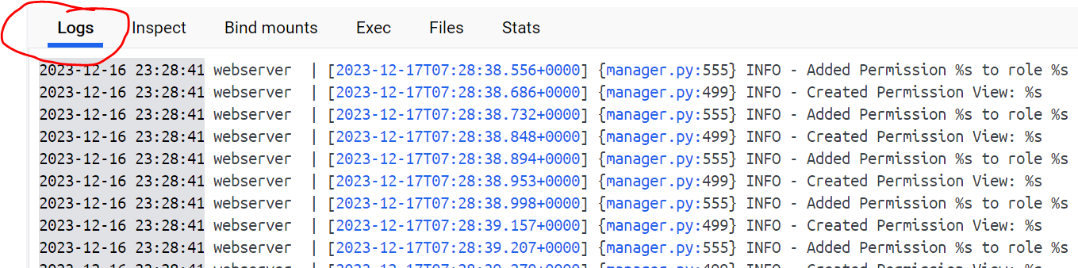
Apache Airflow
Open docker App:
Click on Containers
Click on running container ‘Workspace’
Click on ‘View Details’
Can check container specific log details
Ref: https://www.youtube.com/watch?v=N3Tdmt1SRTM&t=370s

Slide 18
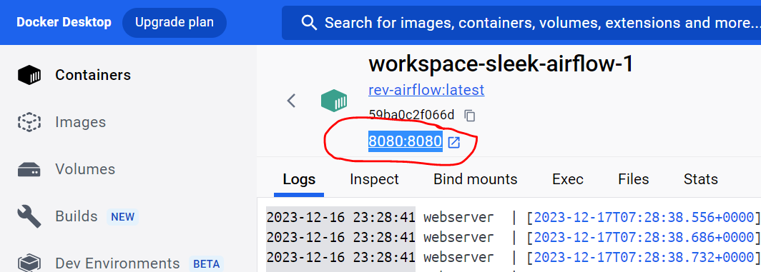
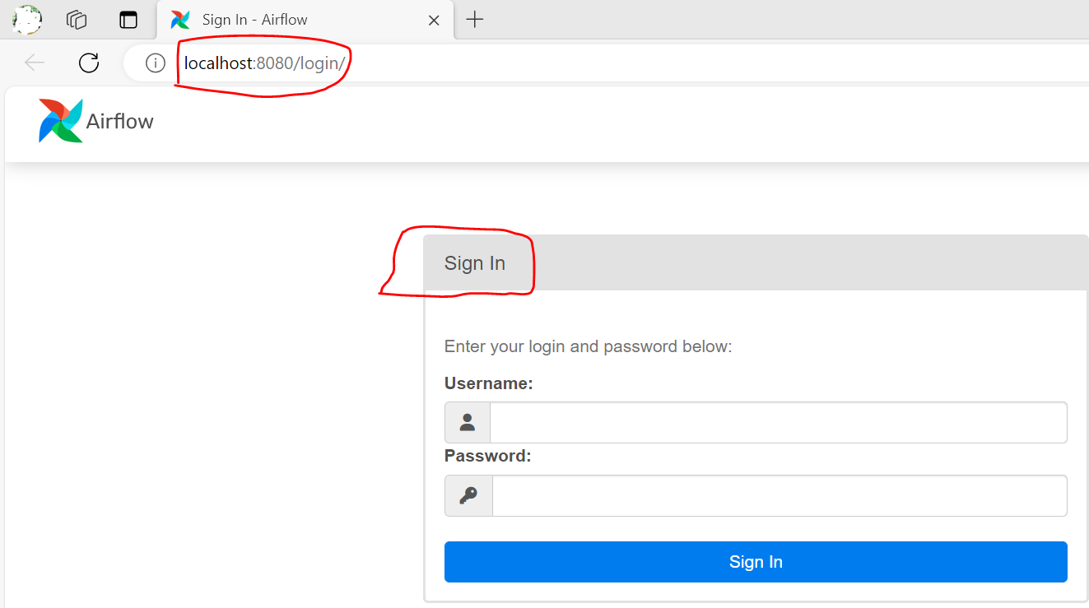
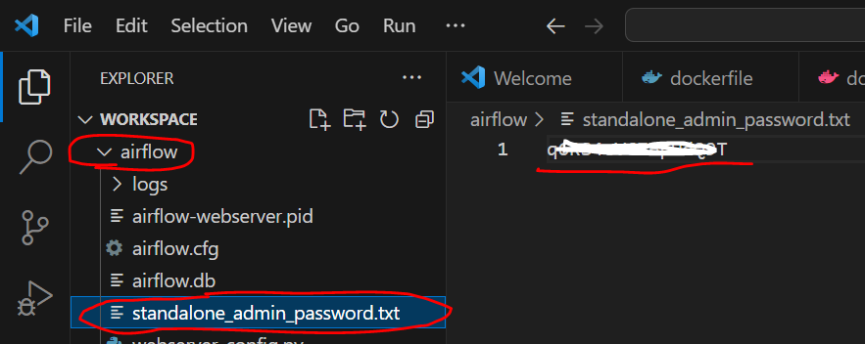
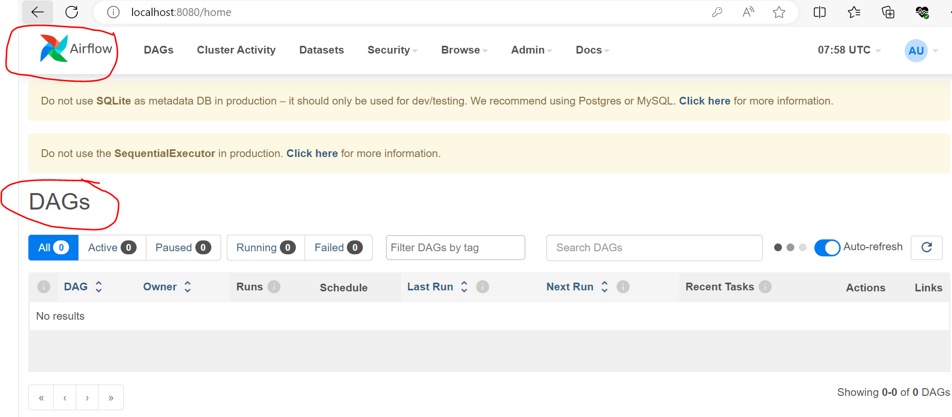
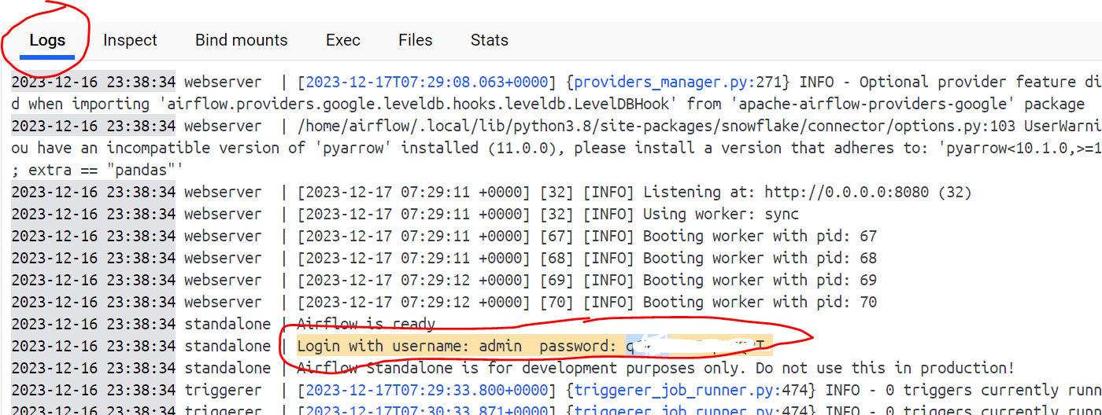
Apache Airflow
Click on ‘8080:8080⁠’ to open the web interface and sign in with username and password
Username (default): admin
Pwd: Can be found in VS Code > Workspace > airflow> standalone_admin_password.txt
Alternatively the pwd can be found in the logs
Ref: https://www.youtube.com/watch?v=N3Tdmt1SRTM&t=370s

Slide 19
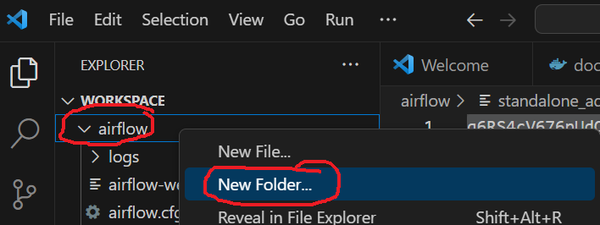
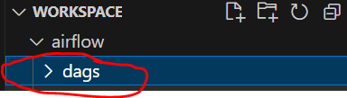
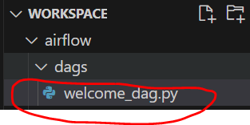
Apache Airflow
Develop and schedule an Airflow DAG:
In VS Code under ‘airflow’ create a new directory/folder named ‘dags’
Inside ‘dags’ directory create a file named ‘welcome_dag.py’
Ref: https://www.youtube.com/watch?v=N3Tdmt1SRTM&t=370s

Slide 20
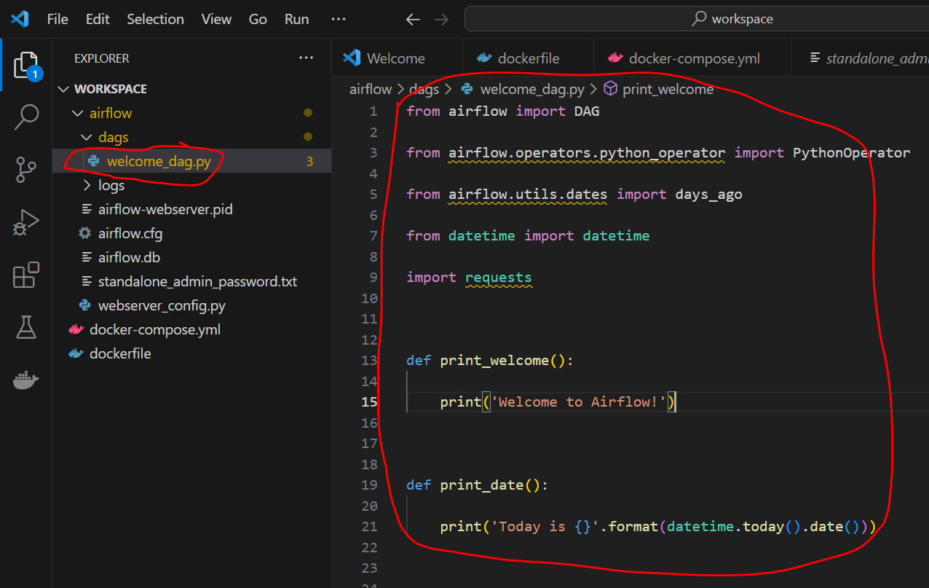
Apache Airflow
Paste the below code in ‘welcome_dag.py’ and save the file
from airflow import DAG
from airflow.operators.python_operator import PythonOperator
from airflow.utils.dates import days_ago
from datetime import datetime
import requests
def print_welcome():
print('Welcome to Airflow!')
def print_date():
print('Today is {}'.format(datetime.today().date()))
def print_random_quote():
response = requests.get('https://api.quotable.io/random')
quote = response.json()['content']
print('Quote of the day: "{}"'.format(quote))
# Schedule the DAG to run daily at 11pm
dag = DAG(
'welcome_dag',
default_args={'start_date': days_ago(1)},
schedule_interval='0 23 * * *',
catchup=False
)
# Print Welcome message
print_welcome_task = PythonOperator(
task_id='print_welcome',
python_callable=print_welcome,
dag=dag
)
# Display current date
print_date_task = PythonOperator(
task_id='print_date',
python_callable=print_date,
dag=dag
)
# Print random quote from a website
print_random_quote = PythonOperator(
task_id='print_random_quote',
python_callable=print_random_quote,
dag=dag
)
# Set the dependencies between the tasks
print_welcome_task >> print_date_task >> print_random_quote

Slide 21
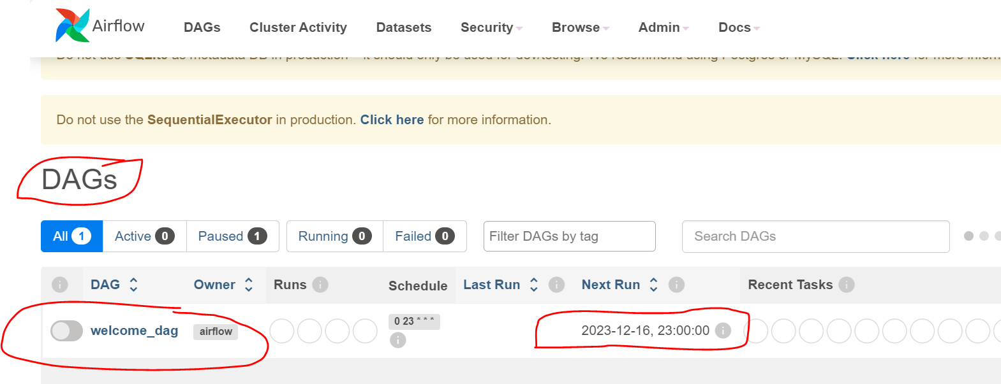
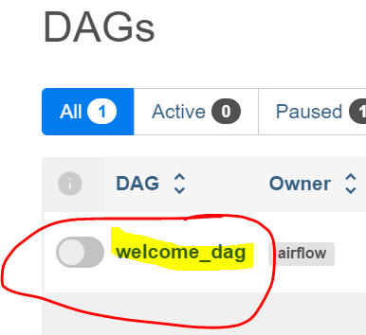
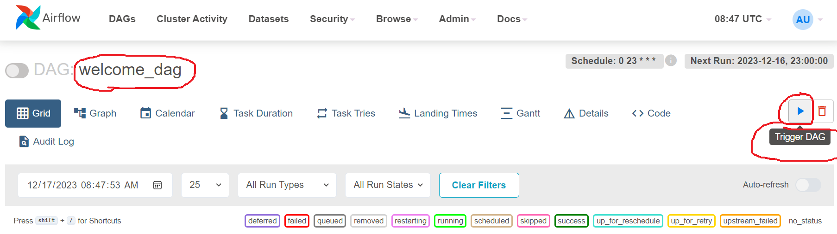
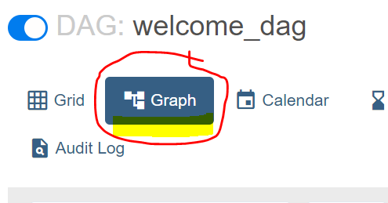
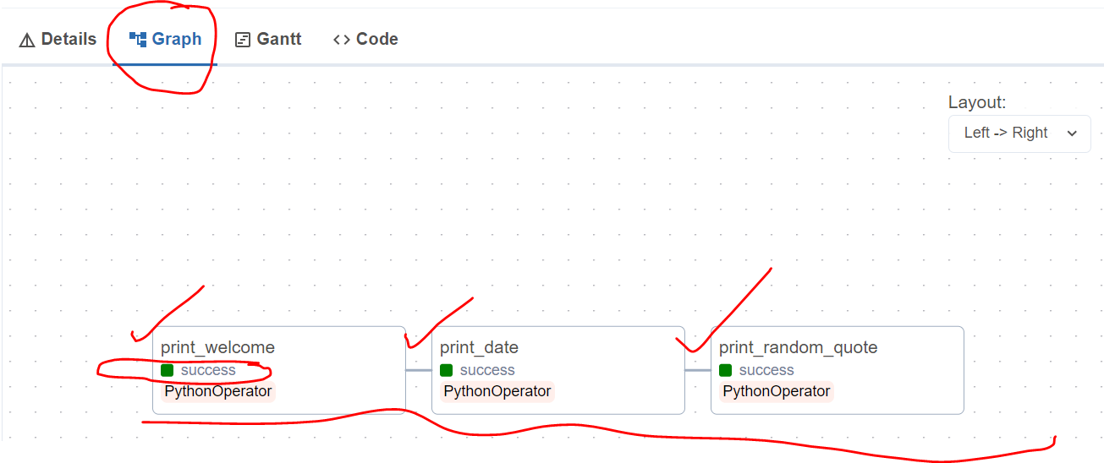
Apache Airflow
It will take 5 mins for the DAG to be visible in the Airflow User Interface
Refresh the page to see the DAG named as ‘welcome_dag’
As defined: it is scheduled to run at 11pm
Currently manually trigger the DAG
Click Graph and 3 tasks should be completed successfully

Slide 22
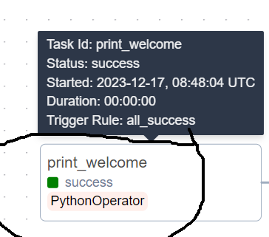
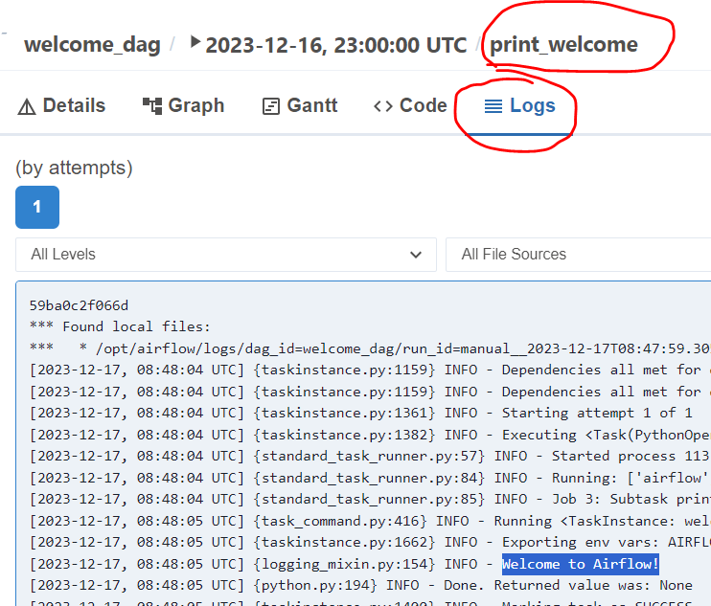
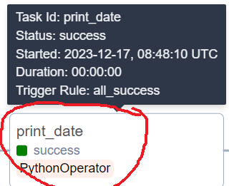
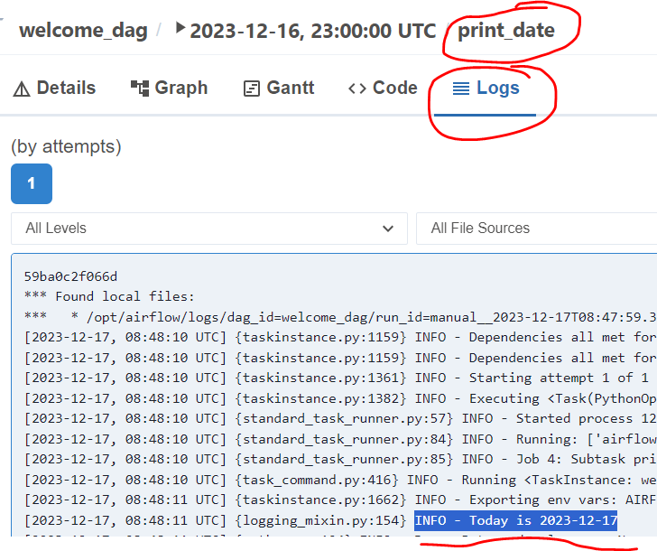
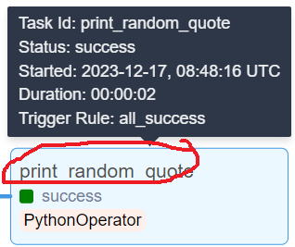
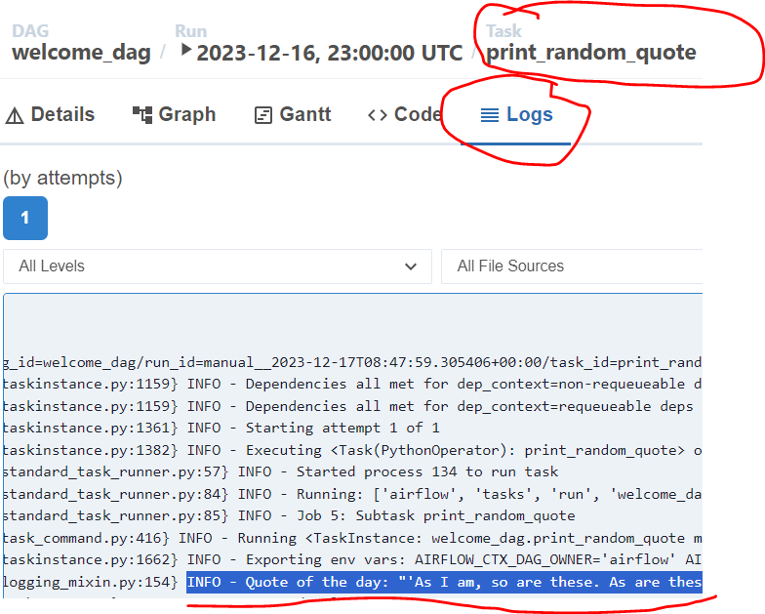
Apache Airflow
Check Logs for the executed Tasks:
Click > print_welcome > Logs
Click > print_date > Logs
Click > print_date > Logs
WORKS as Expected
- Shows welcome message
WORKS as Expected
- Shows todays date
WORKS as Expected
- Shows random quote

Slide 23
Apache Airflow
Project2:

Slide 24
Apache Airflow
Airflow Configuration
DAG deep dive
Operator Types
Provider Packages

Slide 25
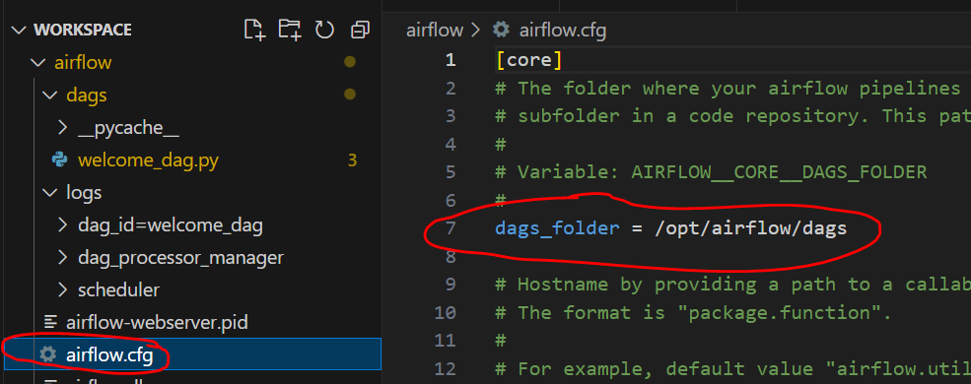
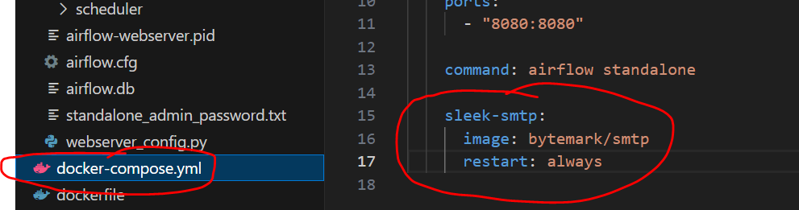
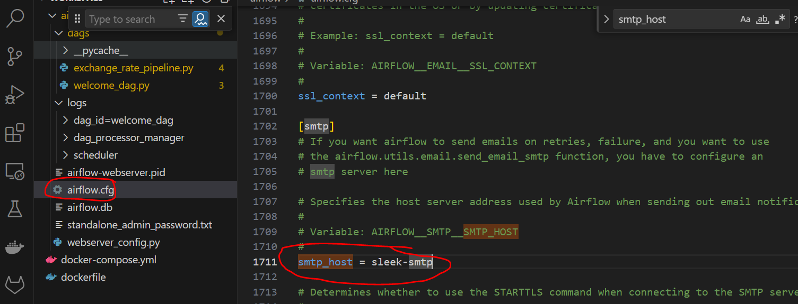
Apache Airflow
every airflow setup has a dags folder.
you can set this folder path in the airflow configuration file named 'airflow.cfg’
configuration file has many other settings that you can customize to meet your needs
Example: to enable airflow instance to send email notifications:
added another Docker container in the Docker compose
this new container will locally host a simple SMTP server
then update the airflow configuration file to use the corresponding Docker service name as the smtp host

Slide 26
Apache Airflow
Sections inside a dag:
in general we begin with import
statements
we should always import the dag class
in addition import the airflow operators
that you are planning to use in your
tasks
we may also need to import any functions
you use whether they are built-in or
user defined
for example in my case I developed a
custom python function called clean data
which is placed in the plugin folder
because I intend to use the clean data
function in this tag I've included it in
the Imports section

Slide 27
Apache Airflow – Reference Links
Custom Operators:
https://www.youtube.com/watch?v=fLEViuvdbPo
Scheduling Options
https://www.youtube.com/watch?v=kPI2mPs-eQA
https://www.youtube.com/watch?v=DYC4-xElccE
https://www.youtube.com/watch?v=bwi_xkTmv4I
Plugins:
https://www.youtube.com/watch?v=Ej2Nl4sNstw
Airflow Tutorial:
https://www.youtube.com/watch?v=vfDB9fpH4tI&list=PLc2EZr8W2QIAI0cS1nZGNxoLzppb7XbqM&index=10
https://www.youtube.com/@SleekData
https://www.youtube.com/watch?v=OuRiX1XQgyY
Other Learning materials / tutorials on Airflow:
https://github.com/jghoman/awesome-apache-airflow?tab=readme-ov-file#introductions-and-tutorials
https://www.youtube.com/playlist?list=PLzKRcZrsJN_xcKKyKn18K7sWu5TTtdywh
https://airflow.apache.org/docs/apache-airflow/1.10.12/concepts.html
Kubectl basics for beginners | Kubernetes
https://www.youtube.com/watch?v=feLpGydQVio

